Slide 1
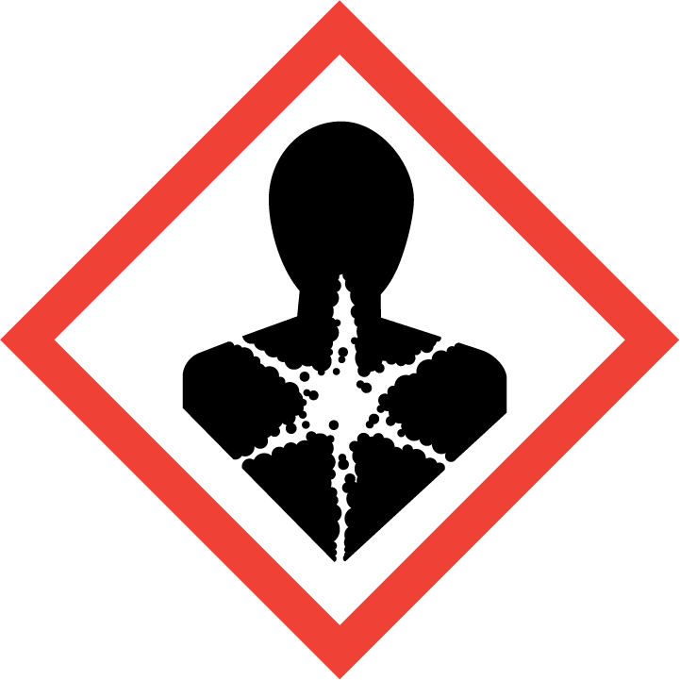

A GHS Label for Inner Packaging – Maleic Anhydride (Without Transport Information)
Maleic Anhydride
CAS number: 108-31-6 EC number: 200-659-6
Index-No: 603-001-00-X
Manufactured by or supplied by
xxxChemicals
Xxx xxxx, The Netherlands
Tel:+31-652xxxx
www.xxxchemicals.com
The product identifier must be the same as that
used on SDS;
Nominal quantity is required if the product is sold
to the general public;
Hazard pictograms should be in the shape of a
square set at a point (diamond shape), and should
have a black symbol on a white background
with a red border. Each hazard pictogram should
cover at least one fifteenth of the surface area of the
harmonized label, but the minimum area shall not be
less than 1 square centimeters.
The requirement of the size of a GHS label in EU
Danger
Harmful if swallowed.
Causes severe skin burns and eye damage.
May cause allergy or asthma symptoms or breathing
difficulties if inhaled.
May cause an allergic skin reaction.
Do not eat, drink or smoke when using this product.
If swallowed: Call a poison center or
doctor/physician if you feel unwell.
IF inhaled: Remove victim to fresh air and keep at rest in a position comfortable for breathing.
IF on skin(or hair):Remove/Take off immediately all contaminated clothing. Rinse skin with water/shower.
Store locked up.
Capacity of the package | Dimensions of label(mm)
≤ 3 litres | If possible at least 52 x 74
> 3 litres but ≤ 50 litres | At least 74 x 105
> 50 litres but ≤ 500 litres | At least 105 x 148
> 500 litres | At least 148 x 210

Slide 2

A GHS Label for Single Packaging and Outer Packaging (with Transport Information Included)
Maleic Anhydride
CAS number: 108-31-6 EC number: 200-659-6
Index-No: 603-001-00-X
Manufactured by or supplied by
xxxChemicals
Xxx xxxx, The Netherlands
Tel:+31-652xxxx
www.xxxchemicals.com
Danger
Harmful if swallowed.
Causes severe skin burns and eye damage.
May cause allergy or asthma symptoms or breathing
difficulties if inhaled.
May cause an allergic skin reaction.
Do not eat, drink or smoke when using this product.
If swallowed: Call a poison center or
doctor/physician if you feel unwell.
IF inhaled: Remove victim to fresh air and keep at rest in a position comfortable for breathing.
IF on skin(or hair):Remove/Take off immediately all contaminated clothing. Rinse skin with water/shower.
Store locked up.
UN 2215
Maleic Anhydride
1. Where a package consists of an outer and an inner packaging, together with any intermediate packaging, and the outer packaging meets labelling provisions in accordance with the rules on the transport of dangerous goods, the inner and any intermediate packaging shall be labelled in accordance with this Regulation. The outer packaging may also be labelled in accordance with this Regulation. Where the hazard pictogram(s) required by this Regulation relate to the same hazard as in the rules for the transport of dangerous goods, the hazard pictogram(s) required by this Regulation need not appear on the outer packaging. - EU CLP Regulation/GHS.

